Slide 1

Multi Document Summarization
Submitted by :
Abhishek Gangwar 15CS60R24
Ajay Jaiswal 15CS60R10
Krunal Parmar 15CS60R13
Piyush Balwani 15CS60R25
Guided by :
Dr. Animesh Mukherjee

Slide 2
Contents
Introduction and Dataset Used
Previous works
Paper Implementation:
KL- Divergence
ProbSum Method
Clustering with Page Rank
Merging of summaries from different approach.
Future Work
References

Slide 3
Introduction and Dataset Used
The Document Summarization is defined as to find a representative subset of the data, which contains the information of the entire document. Similarly, Multi-document summarization is an procedure of extraction of data from multiple texts written about the same topic.
Dataset used: Document Understanding conferences(DUC), which contains
Context text
Abstract Summary
Previous work:
Express each sentence of the Document as a feature vector. Calculating Cosine Similarity between contexts and create the network . Calculate degree , average shortest path and locality index strategy for each node and rank accordingly and selected top ranked sentences.

Slide 4
Paper Implementations
KL Divergence
Probsum Method
Clustering with Page Rank.
Reference:
Aria Haghighi, Lucy Vanderwende
Exploring Content Models for Multi-Document Summarization
Human Language Technologies: The 2009 Annual Conference of the North American Chapter of the ACL, pages 362–370,
http://www.aclweb.org/anthology/N09-1041

Slide 5


KL - Divergence
This system aims to minimize the Kullback-Leibler (KL) divergence between the word probability distribution of the summary and that of the input.
KL-Divergence KL( P||Q) =
Where P(w) is the unigram probability distribution of the whole document and Q(w) is
the unigram probability of the each candidate sentence for the summary.

Slide 6
Paper Implementations
KL Divergence
Probsum Method
Clustering with Page Rank.
(link here)

Slide 7
ProbSum method
This method scores a sentence by taking the average of word probabilities over the words in the sentence, with stopwords assigned zero weights.
Step 1 : Compute the probability distribution over the words wi appearing in the input, p(w_{i}) for every i.
p(w_{i}) = n/N ,
where n is the number of times the word appeared in the input,
and N is the total number of content word tokens in the input.
Only verbs, nouns, adjectives and numbers are considered in the computation of the probability distribution.

Slide 8
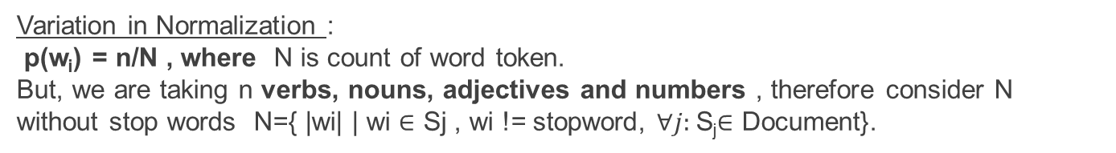
Step 2 : Assign an importance weight to each sentence S
Weight(S_{j}) = CF[p(w_{i})] for w_{i} ∈ S_{j}
Step 3 : Pick the best scoring sentence under the scoring function CF from the previous step.
Step 4 : If the desired summary length has not been reached, go back to Step 2.
Variation in Normalization :
p(w_{i}) = n/N , where N is count of word token.
But, we are taking n verbs, nouns, adjectives and numbers , therefore consider N without stop words N={ |wi| | wi $∈$ Sj , wi != stopword, $∀j:$S_{j}$∈$ Document}.

Slide 9
Paper Implementations
KL Divergence
Probsum Method
Clustering with Page Rank.
(link here)

Slide 10
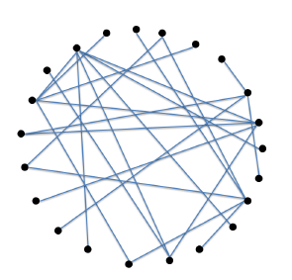
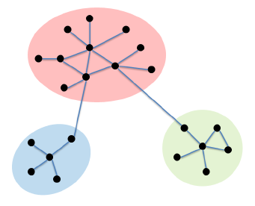
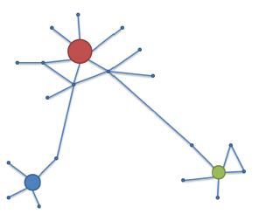
C-LexRank Illustration
Document sentence network
Community Structure
C–LexRank Output

Slide 11
Algorithm and Variations
Split document into set of sentences.
Represent each sentence as a vector considering Unigram and Bigram feature.
Create a document sentence network using a distance measure (Cosine, Euclidian Distance).
Run the clustering algorithm (K-mean, Hierarchical Clustering)
Order the cluster based on their importance. (Measure – by order of cardinality of set of sentences in cluster)
PageRank on each cluster.
Take highly ranked sentences from each cluster to form summary till its length exceed 100 words.
Evaluation of summary obtained (ROUGE).

Slide 12












C-LexRank Algorithm
Document d = {${ s}_{i} |$set of sentences where 0< i <=|d| }
Clustering
$${ C}_{1}$$
$${ C}_{2}$$
$${ C}_{3}$$
$${ C}_{4}$$
$${ C}_{5}$$
$${ C}_{6}$$
Page Rank on each cluster
$${ s}_{c1}$$
$${ s}_{c2}$$
$${ s}_{c3}$$
$${ s}_{c4}$$
$${ s}_{c5}$$
$${ s}_{c6}$$
Summary
[1] http://www.cse.psu.edu/~zzw109/pubs/AAAI2015-NeuralProbabilisticModelCitationRecommendation.pdf

Slide 13
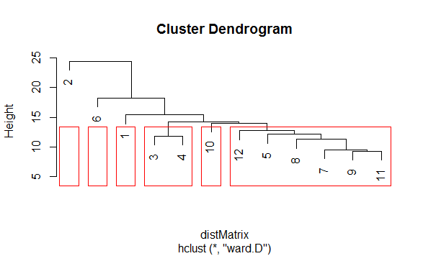
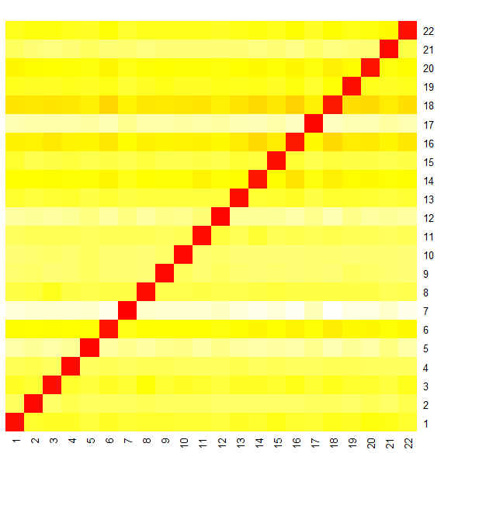
C-LexRank Algorithm
Dendrogram for the clustering of sentences (22 sentences)and cluster formation.
Heat Map graph for Euclidean distance between all sentences of document (22 sentences in a document).

Slide 14
Merging of Summaries obtained using different methods

Slide 15

PAGE RANK
S43
SN1
S11
S11
S12
S13
S14
S22
S63
S52
PAGE RANK
S22
C
L
U
ST
E
R
I
N
G
A
L
G
O
S12
SN2
S31
S42
S31
S21
S22
S23
S24
S11
S12
S13
S14
S71
S61
PAGE RANK
S22
S24
S31
S14
S24
S21
S22
S23
S24
--
--
--
SN1
SN2
SN3
SN4
S24
SN4
-
-
-
-
S62
S54
S54
S13
PAGE RANK
S33
S54
S32
S74
S13
PAGE RANK
SN1
SN2
SN3
SN4
S13
S23
S33
PAGE RANK
S33

Slide 16
PAGE RANK
S43
SN1
S11
S11
S12
S13
S14
S22
S63
S52
PAGE RANK
S22
C
L
U
ST
E
R
I
N
G
A
L
G
O
S12
SN2
S31
S42
S31
S21
S22
S23
S24
S11
S12
S13
S14
S71
S61
PAGE RANK
S22
S24
S31
S14
S24
S21
S22
S23
S24
--
--
--
SN1
SN2
SN3
SN4
S24
SN4
-
-
-
-
S62
S54
PAGE RANK
S54
S54
S32
S74
SN1
SN2
SN3
SN4
S13
S23
S33

Slide 17
To be implemented:
Position likelihood distribution for matching in database:
In terms of our baseline system, we use sparse vectors containing all n APs and a Gaussian kernel to calculate the likelihood for each system anchor, which is robust and efficient according to the results of our preliminary experiments.
Show path and directions from User to fetched book location.
Dead reckoning(If possible):
Process of calculating one's current position by using a previously determined position to show the user’s navigation.

Slide 18
Thank You

